Slide 1

Course Name: Hardware Security
Faculty Name: Prof Debdeep Mukhopadhyay
Department : Computer Science and Engineering
Topic
Lecture 24: Introduction to Side Channel Analysis

Slide 2

Concepts Covered:
What is Side Channel Analysis?
Types of Side Channel
Brief History
Timing Attack
Power Analysis and Types

Slide 3
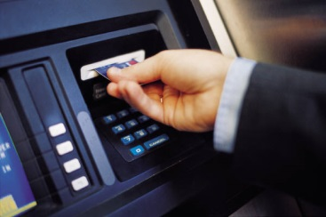
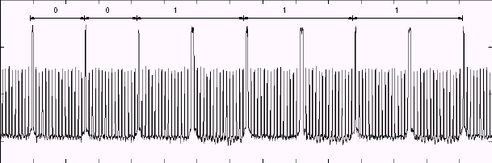
Strong cryptographic algorithms are just the beginning!
Data input
Terminal
IC chip
Data output
Power supply
00111…
Measure power consumption
Guess secret information stored on IC chip memory
Power consumption
Secret information
0
0
1
1
1
1
Notes:
With side channel attacks it is possible to break implementations of cryptosystems even though no mathematical attack is known to solve the underlying problem. With SPA, one power trace is sufficient to reveal the secret.

Slide 6
Side Channel Sources
Threat Model & Security Goal
Key dependent
Variations computation time
Traditionally we have handled only
Cryptographic Algorithms
Protocols
Software
Human User
Hardware
Power consumption
EM Radiations
Test Methodologies
Behavior under faults
E/D
It is impossible to design a totally secure system with humans in it
K
Deployment
& Usage
Real World System

Slide 7
What are Side Channels?
These are covert channels which leak information which the designers of cryptographic algorithms did not consider.
Information is leaked because of the implementation:
optimization leads to information leakage
example: an if-else statement in a programming language

Slide 8
A Brief History of Side Channels
World War 1, telephones used in battle fields had just one wire and used the earth to carry the return current.
Spies would insert rod in the ground and connect them to amplifiers in order to pick up conversation.
World War II, Bell Labs were the first to discover that electromagnetic emissions from devices could leak 75% of the plaintext that was sent securely from a distance of 80ft.
During 1950s, Americans used radiations from encoding devices to spy on encrypted Russian message transmission.
These attacks were studied by Americans, under the code named Tempest, to identify the shielding methods for equipments.
In 1985, Win van Eck published the first unclassified report which showed how low cost equipments could be used to eavesdrop on messages from a distance of few hundred meters using the emanations from cathode ray tube monitors.
More recent studies show how emissions from cables of LCD monitors, wireless keyboards, LED indicators can be picked up and decoded from several feet away.
In the mid 1990s, two seminal papers by Paul C Kocher showed how execution time and power consumption can be used to easily retrieve secret keys from naïve implementations of ciphers.

Slide 9
Possible Side Channels
Timing
Power
Electro-Magnetic radiations
Faults
Testability Features in Hardware
and may be many more…

Slide 10
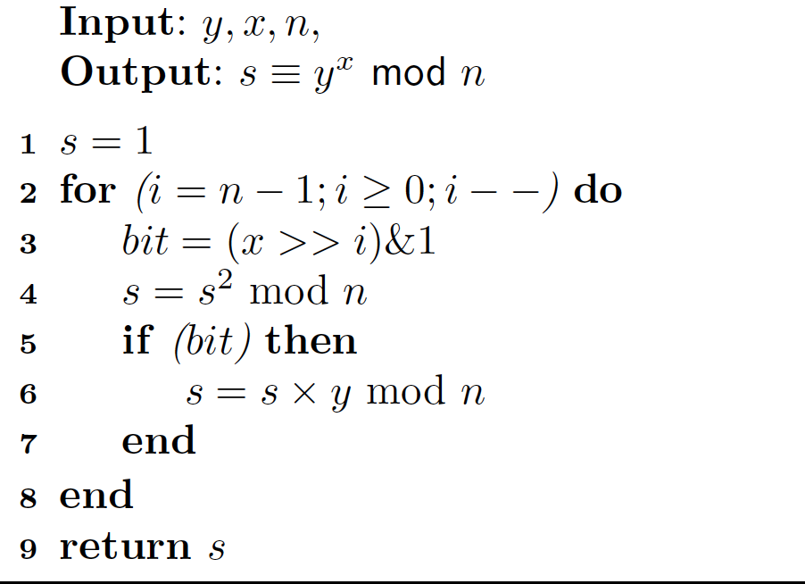
Square and Multiply Algorithm
We assume that the attacker knows the first b-1 bits, and wants to obtain the b-1th bit of the secret key.
Attacker knows x[0],…,x[b-2] and wants to determined x[b-1]
Paul C Kocher, Timing Attacks on Implementations of Diffie-Hellman, RSA, DSS and Other Systems, In Proceedings of Crypto, LNCS 1109, pgs 104-113, 1996.

Slide 11
Timing Measurement
Assume that the attacker can measure time accurately for a function P.
Compute the timestamp before and after calling a function P
Then evaluate the difference between the timestamps.
Note if there is no program between two timestamp calls, there is still a small time difference.
This overhead should be appropriately deducted after computing the running time of the program P.

Slide 12
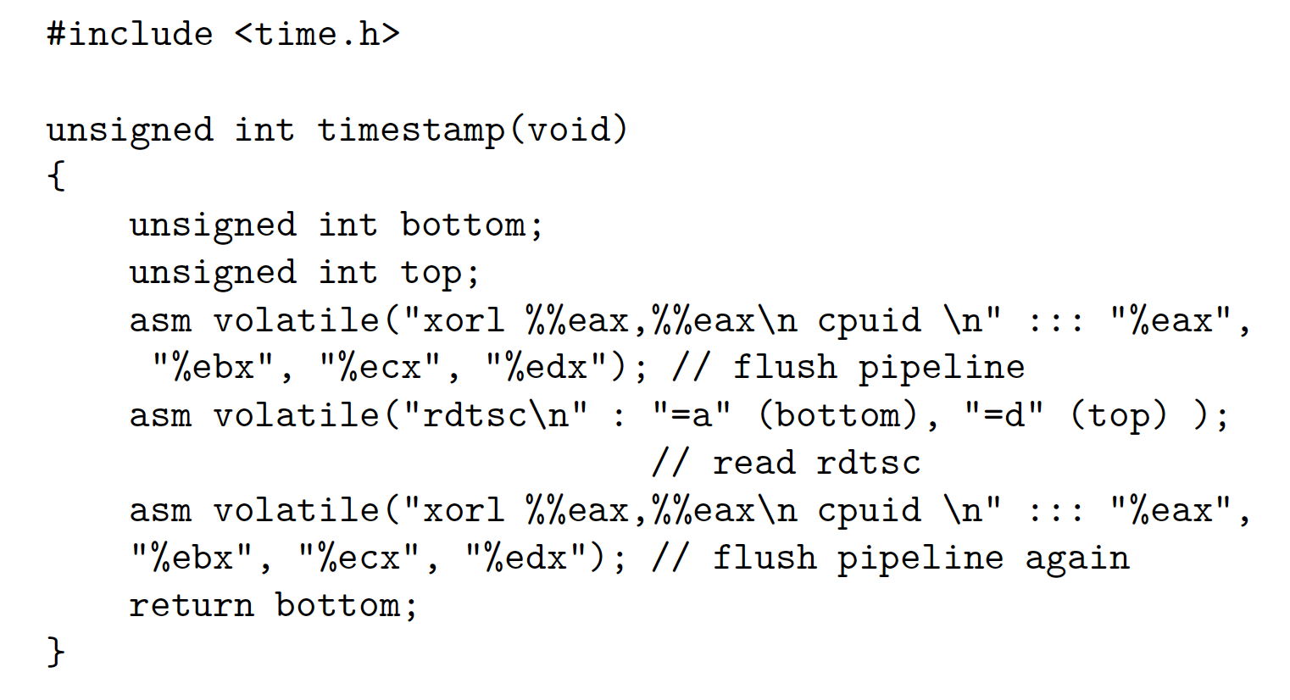
Timestamp Snippet

Slide 13
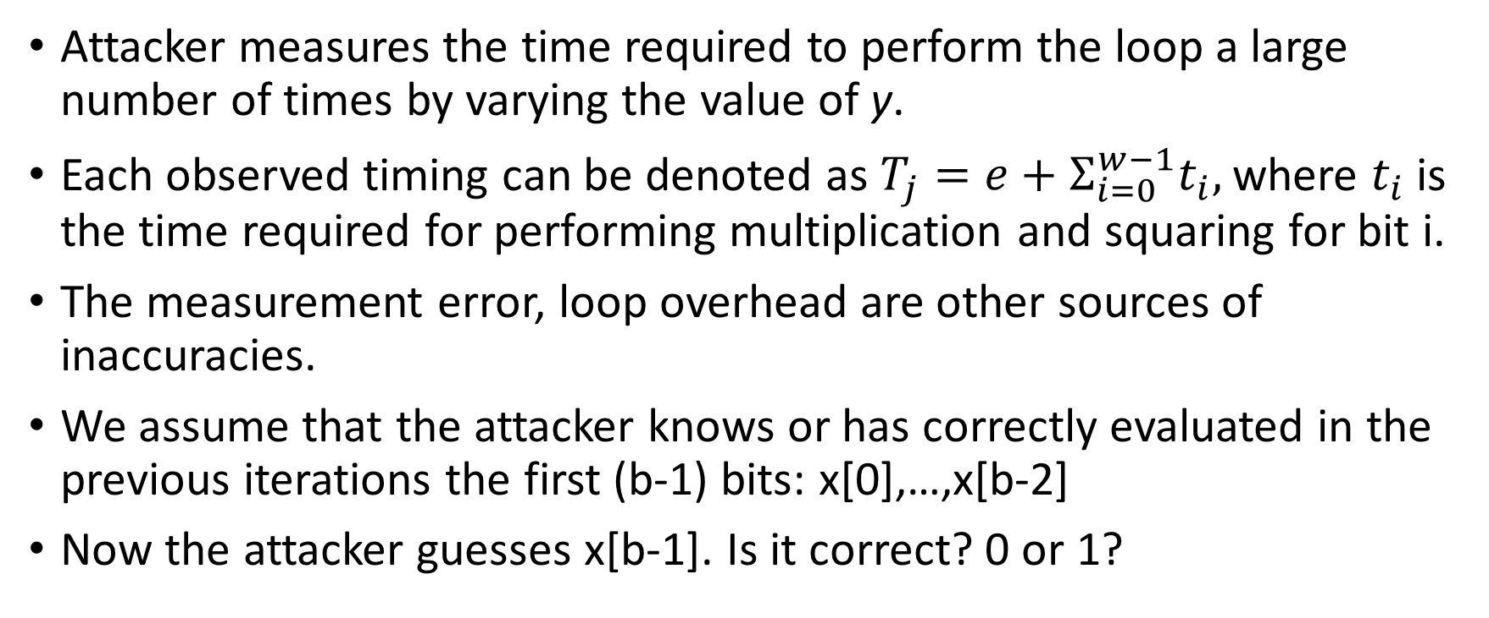
Attack Methodology
Attacker measures the time required to perform the loop a large number of times by varying the value of y.
Each observed timing can be denoted as $T_{j}=e+Σ_{i=0}^{w−1}t_{i},$where $t_{i}$ is the time required for performing multiplication and squaring for bit i.
The measurement error, loop overhead are other sources of inaccuracies.
We assume that the attacker knows or has correctly evaluated in the previous iterations the first (b-1) bits: x[0],…,x[b-2]
Now the attacker guesses x[b-1]. Is it correct? 0 or 1?

Slide 15
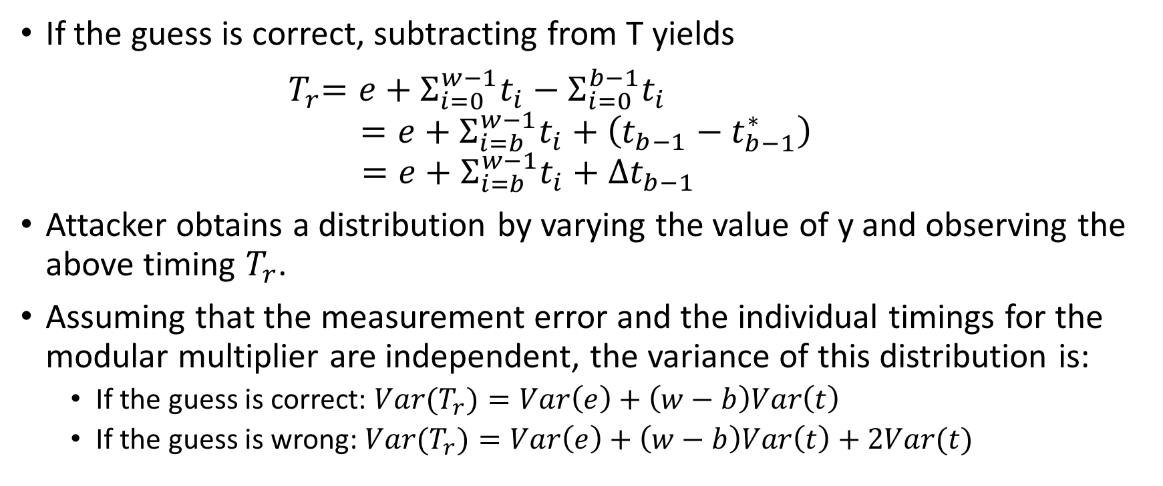
Attack Methodology (contd.)
If the guess is correct, subtracting from T yields
${ T}_{r}=e+Σ_{i=0}^{w−1}t_{i}−Σ_{i=0}^{b−1}t_{i}$
$$=e+Σ_{i=b}^{w−1}t_{i}+\left(t_{b−1}−t_{b−1}^{∗}\right)$$
$$=e+Σ_{i=b}^{w−1}t_{i}+Δt_{b−1 }$$
Attacker obtains a distribution by varying the value of y and observing the above timing $T_{r}$.
Assuming that the measurement error and the individual timings for the modular multiplier are independent, the variance of this distribution is:
If the guess is correct: ${Var(T}_{r})=Var\left(e\right)+\left(w−b\right)Var\left(t\right)$
If the guess is wrong: ${Var(T}_{r})=Var\left(e\right)+\left(w−b\right)Var\left(t\right)+2Var(t)$

Slide 16
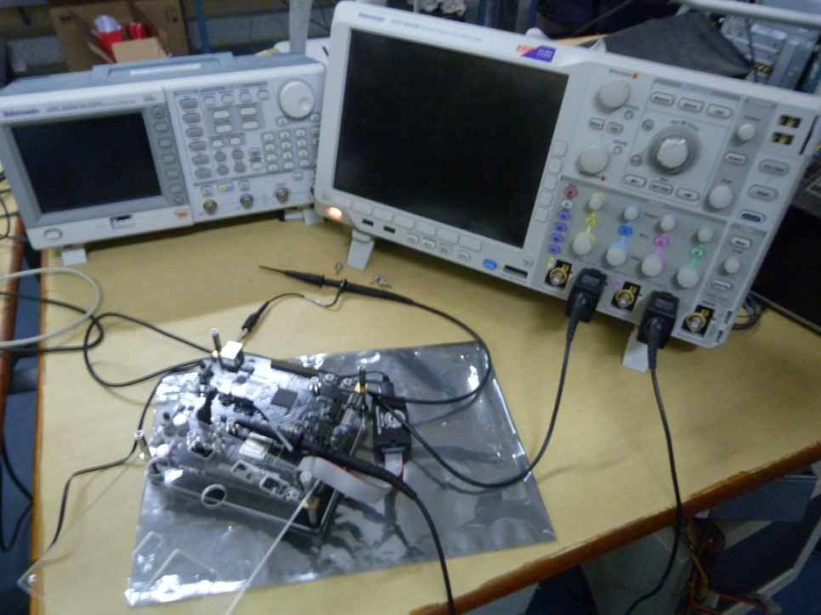
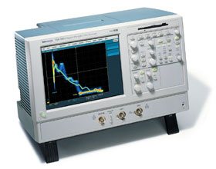
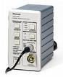
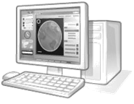
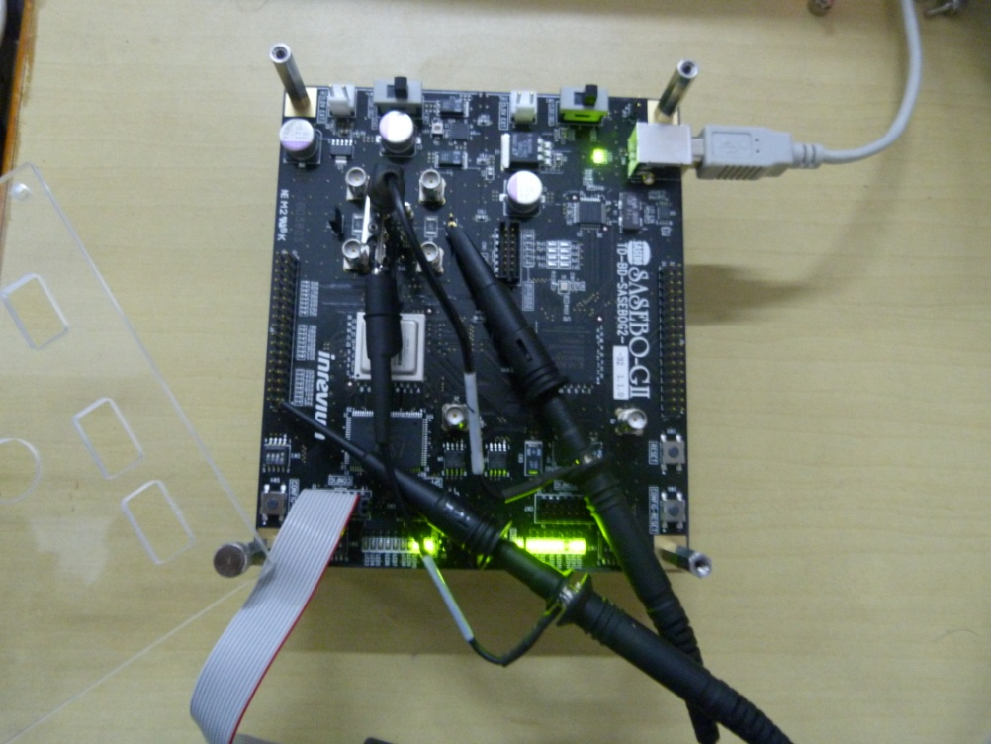
Experiment Set-up @ IIT KGP
2
Controller PC
3
Digital
Oscilloscope
Current
Amplifier
V_{cc}
Controller Pin
1
Current Probe
FPGA Board
DES/3-DES/AES CORE LOGIC (Implemented on FPGA)

Slide 17
Power Attacks
SPA – Simple Power Analysis attacks
Fact exploited - Power consumption at an instant of time is a function of the operation being carried out by the device
DPA – Differential Power Analysis
Fact exploited - Power consumption of the same operation at different instants of time depends on the data being processed.
Paul C. Kocher, Joshua Jaffe, Benjamin Jun:Differential Power Analysis. CRYPTO 1999: 388-397

Slide 18
Simple Power Analysis (SPA)
Directly interprets the power consumption of the device
Looks for the operations taking place and also the key!
Trace: A set of power consumptions across a cryptographic process
1 millisecond operation sampled at 5MHz yield a trace with 5000 points

Slide 19
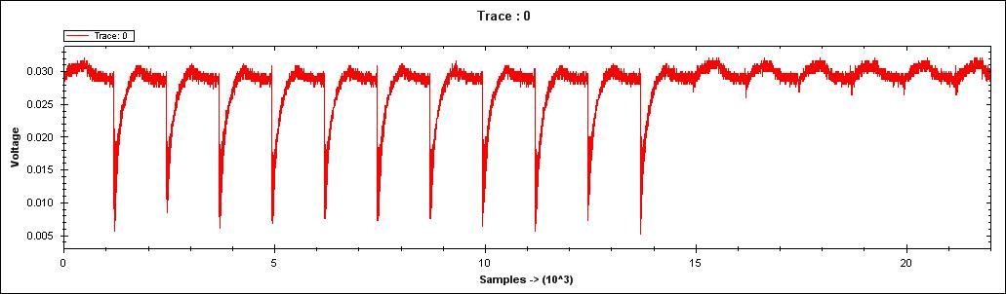
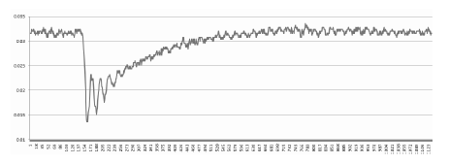
A Power Trace
Power Trace of a round of AES.
Observe the variation of power values.
The variations occur because of the operation dependence of power: leads to SPA.
The variations also occur because of data dependence of power: leads to DPA.

Slide 20
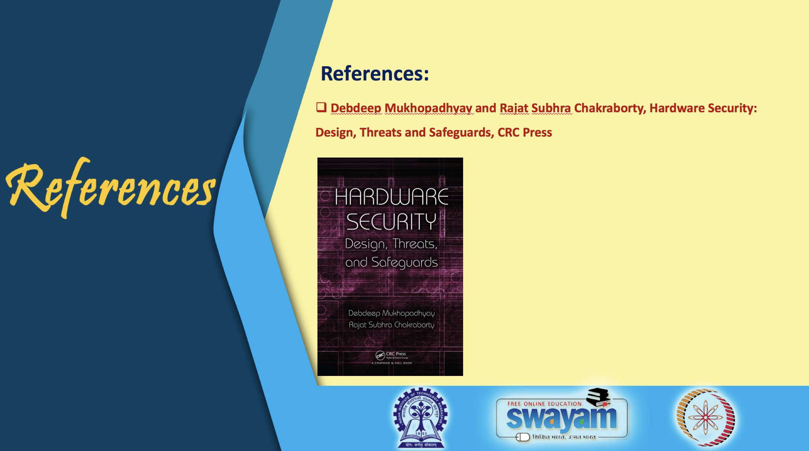
D. Stinson, Cryptography: Theory and Practice, Chapman & Hall/CRC
Lawrence C. Washington, Elliptic Curves: Number Theory and Cryptography, Chapman & Hall/CRC
Jeffrey Hoffstein, Jill Pipher, Joseph H. Silverman, An Introduction to Mathematical Cryptography, Springer.

Slide 21
Conclusion:
Definition of Side Channel Analysis
Brief History
Types of Side Channel Analysis
Kocher’s Timing Attacks
Power Analysis and Types

Slide 22


